Slide 1
The Value of Digital Pathology: Applications for Subspecialization, Biobanking and Patient-centered Pathology
Sylvia L. Asa, MD, PhD
Department of Pathology
University Hospitals Cleveland Medical Center
Case Western Reserve University

Slide 2
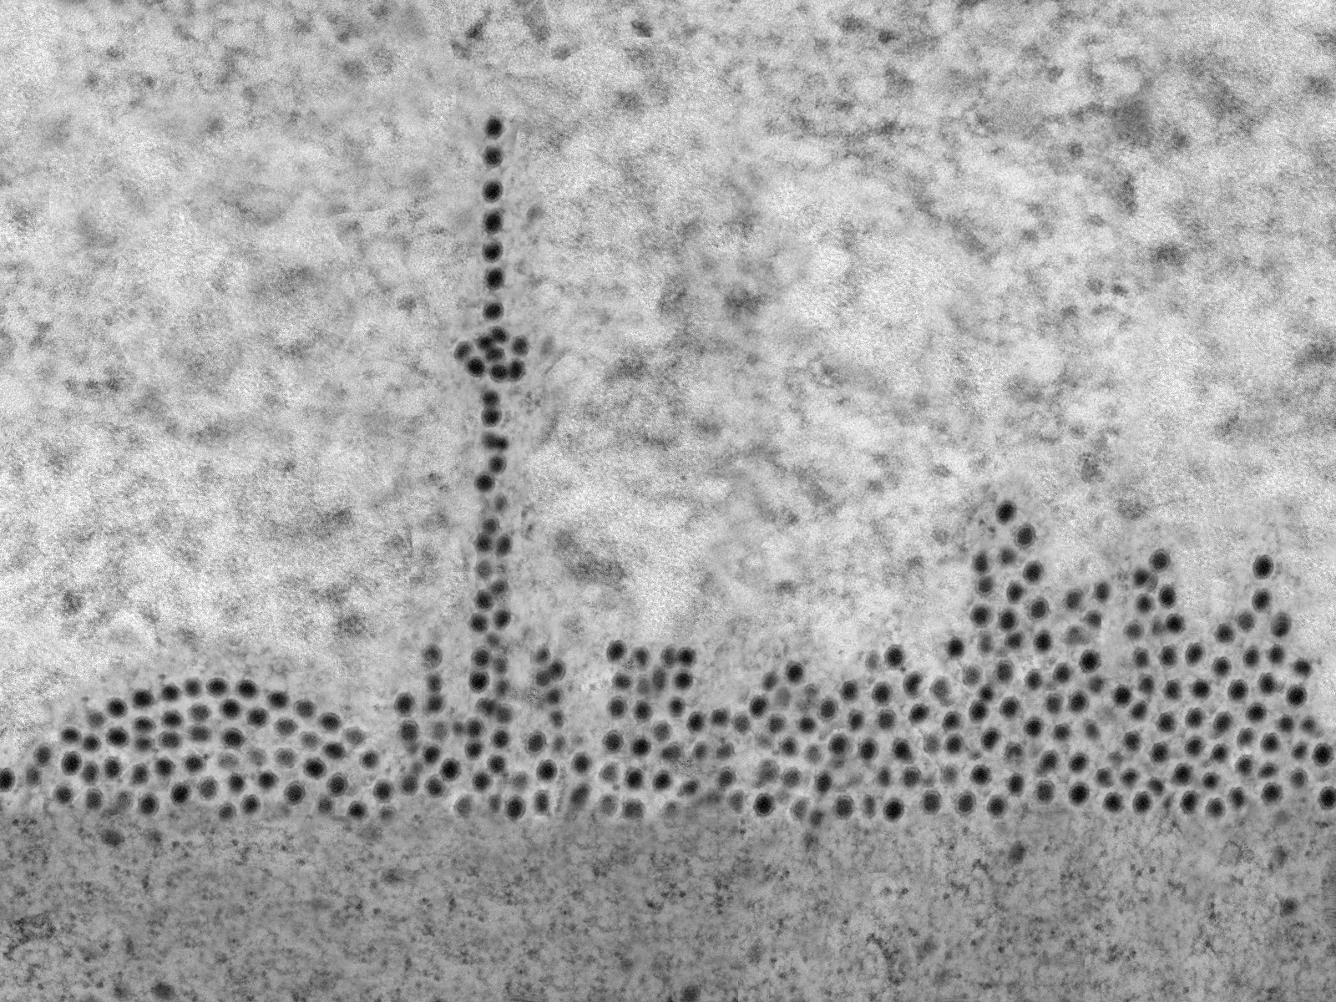
The Beginning of Clinical Digital Pathology
Toronto, Ontario
October 2003
Torontonavirus. The Art Gallery of Pathology, By Rasmus Kiehl, Editor: Sylvia L. Asa, ARP Press 2020
Notes:
It was October 2003. The location: Toronto Ontario Canada. In three years, I had managed to pull together a team of 25 Pathologists from three different institutions with three different cultures. I had achieved pay parity and developed a partnership for extra income. I had convinced each member to focus on their distinct sub specialty and founds ways to ensure workload equivalence. I had purchased brand new beautiful microscopes and armed the histology lab with new equipment, including a rapid tissue processor. The only thing left to do was to finalize a plan for geographic consolidation of the entire department in one location, and that plan was under development.

Slide 3
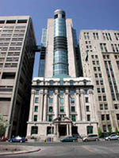
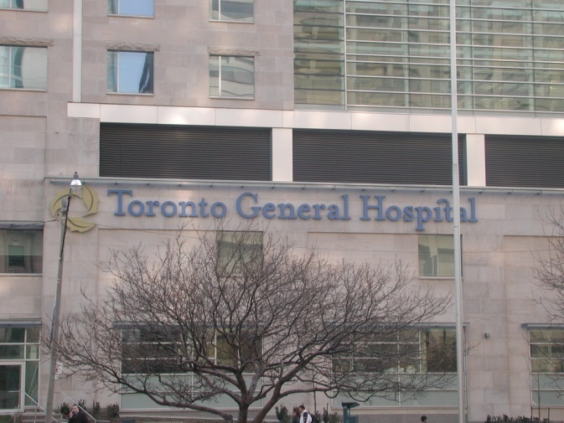
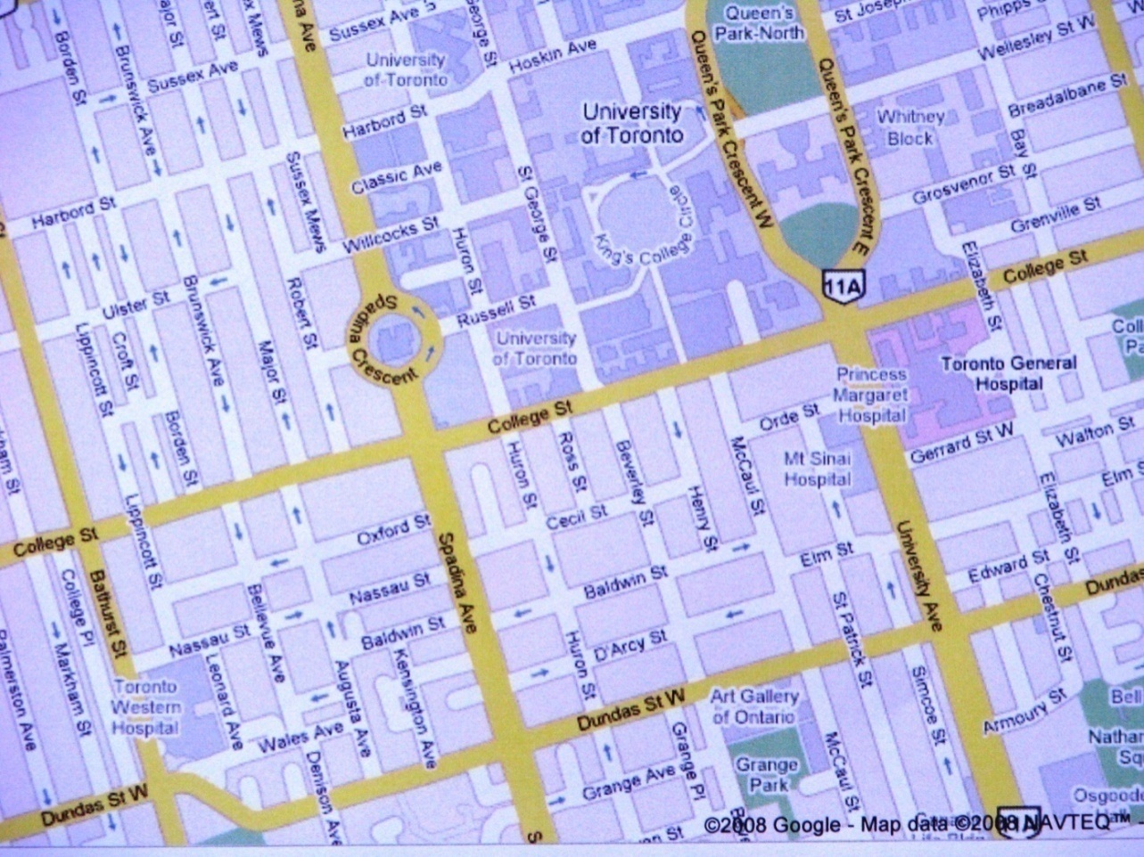
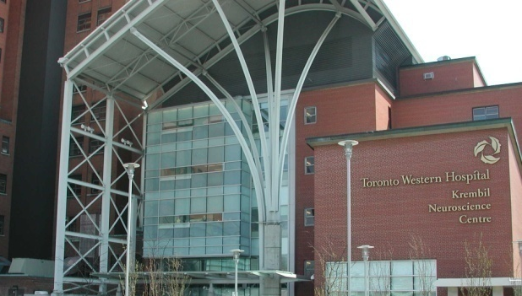
University Health Network a merger of 3 hospitals
Toronto General Hospital
Princess Margaret
Cancer Centre
~ 1.5 mile
*
Toronto Western Hospital

Slide 4
The Challenge of a Multi-Site Institution: Intra-operative Consultation
Laboratory consolidation at TGH
No on-site pathologist at TWH
Low volume of intra-operative consults at TWH
Need for surgical pathology expertise in multiple areas including neuropathology
Adoption of the first application of telepathology –
Intra-operative consultation

Slide 5
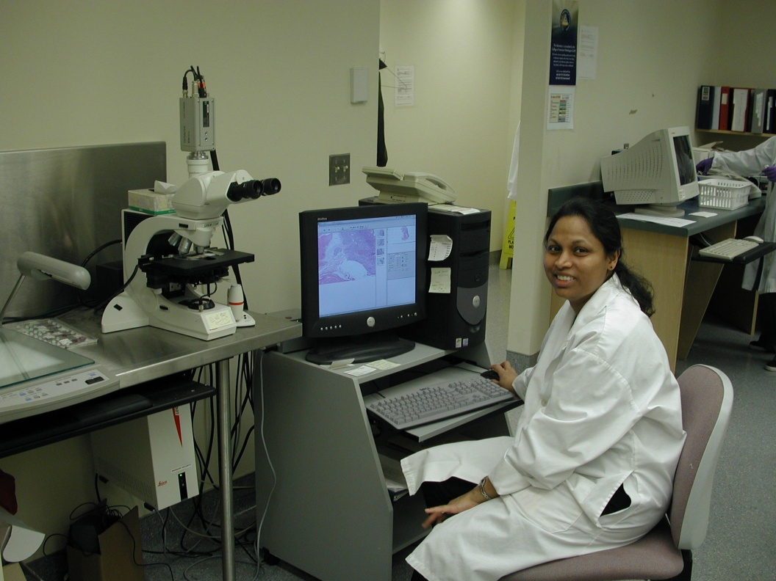
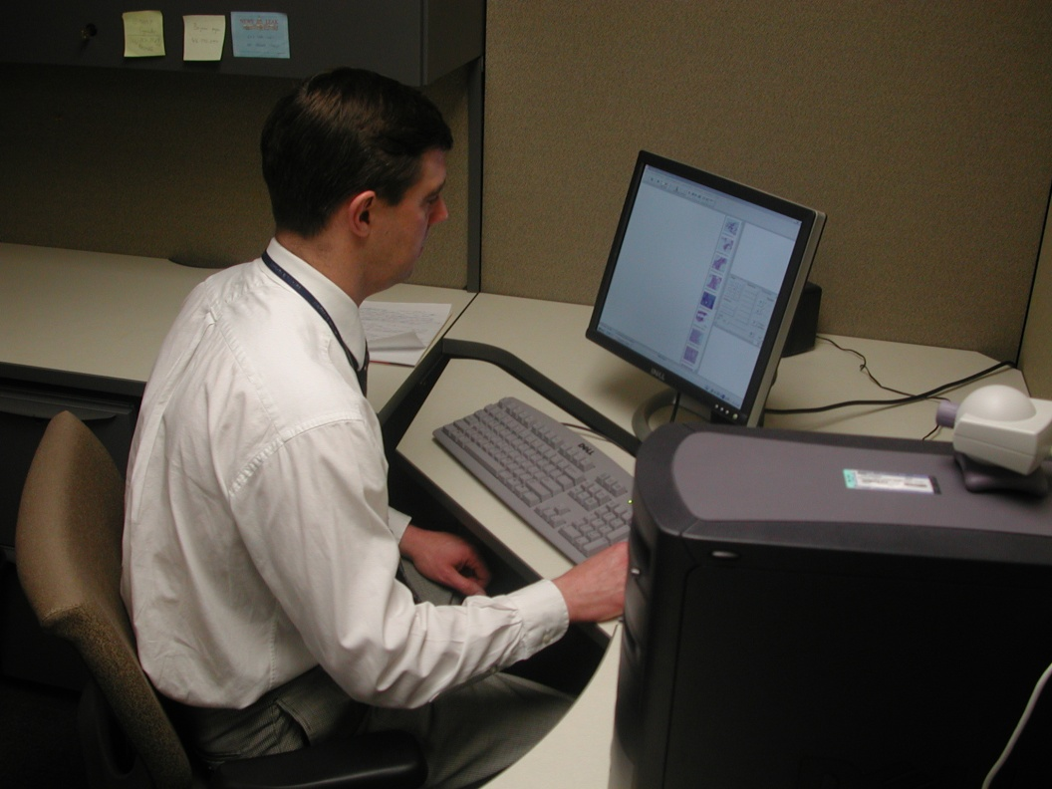
2004: The Robotic Microscope
Suganthini Ilaalagan at
the Toronto Western
Surgical Pathology Suite
Dr. Andrew Evans at
the Toronto General
Telepathology Work Station
TAT average for intraoperative consultations: 9.65 minutes

Slide 6
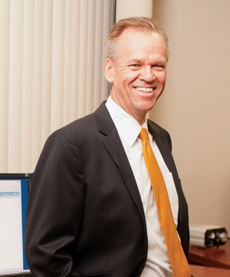
Innovation
an engineer named Dirk Soenksen started a small company he named Aperio (Latin for reveal) that made scanners to convert glass slides into Whole Slide Images (WSI)

Slide 7
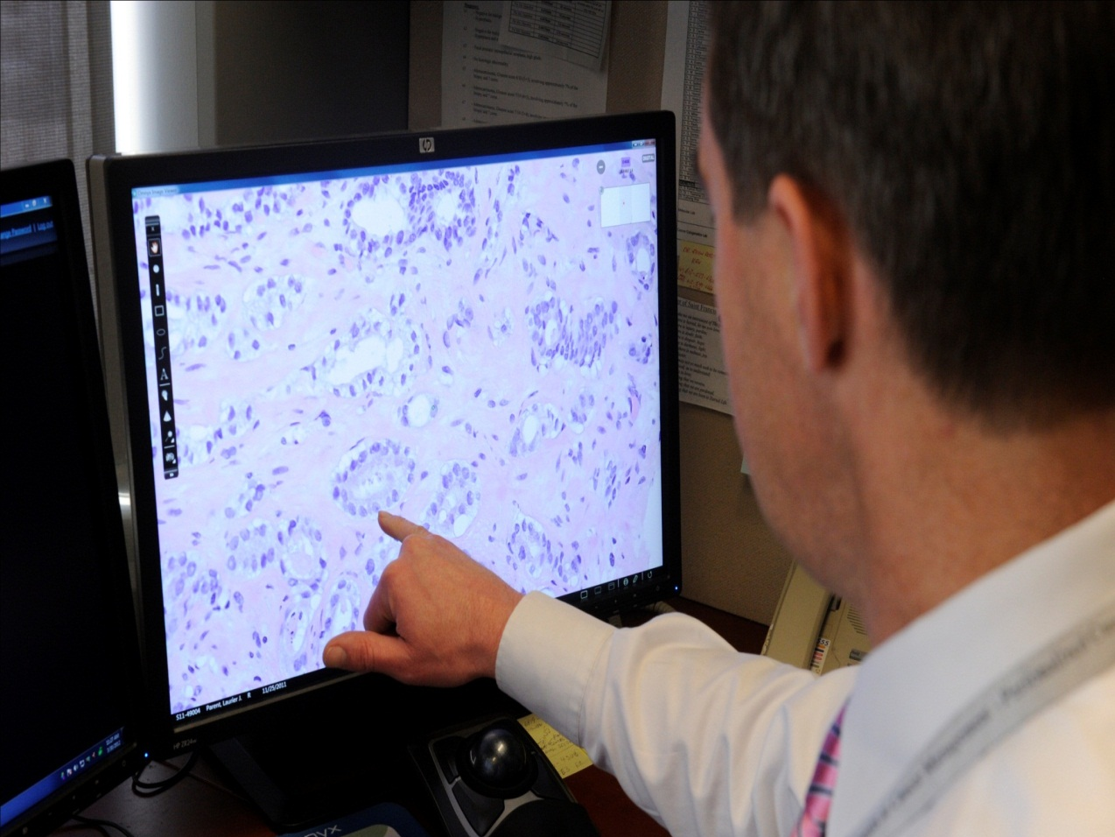
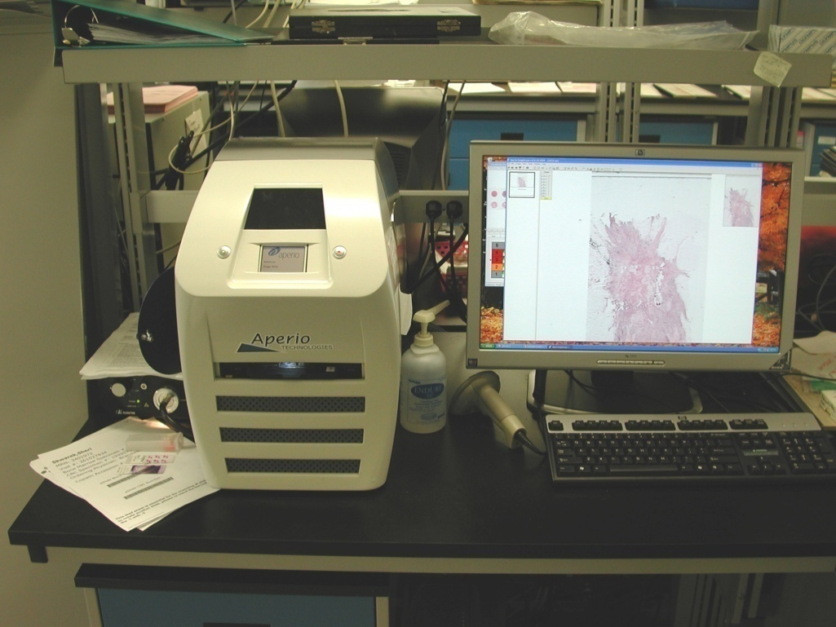
2006: WSI
TAT becomes 2.25 minutes (average)

Slide 8
Digital Pathology Addresses Academic Challenges…..
2007
How do we get the two liver and two renal pathologists to read transplant biopsies and attend academic meetings?
Telepathology solution
all rush biopsies read on laptops at the meeting
pathologists all attend a meeting while supporting service
Pathologist satisfaction
Assurance of job security
“This could make pathology fun again”

Slide 9
WSI Enables Expanded Subspecialty Pathology
Access to subspecialists for after-hours call
Subspecialist coverage of clinical services during major academic meetings
Annotation of a world-class Biobank
International consults

Slide 10
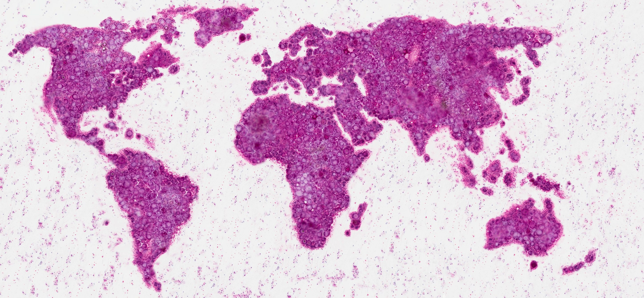
Whorl World. The Art Gallery of Pathology, By Rasmus Kiehl, Editor: Sylvia L. Asa, ARP Press 2020

Slide 11
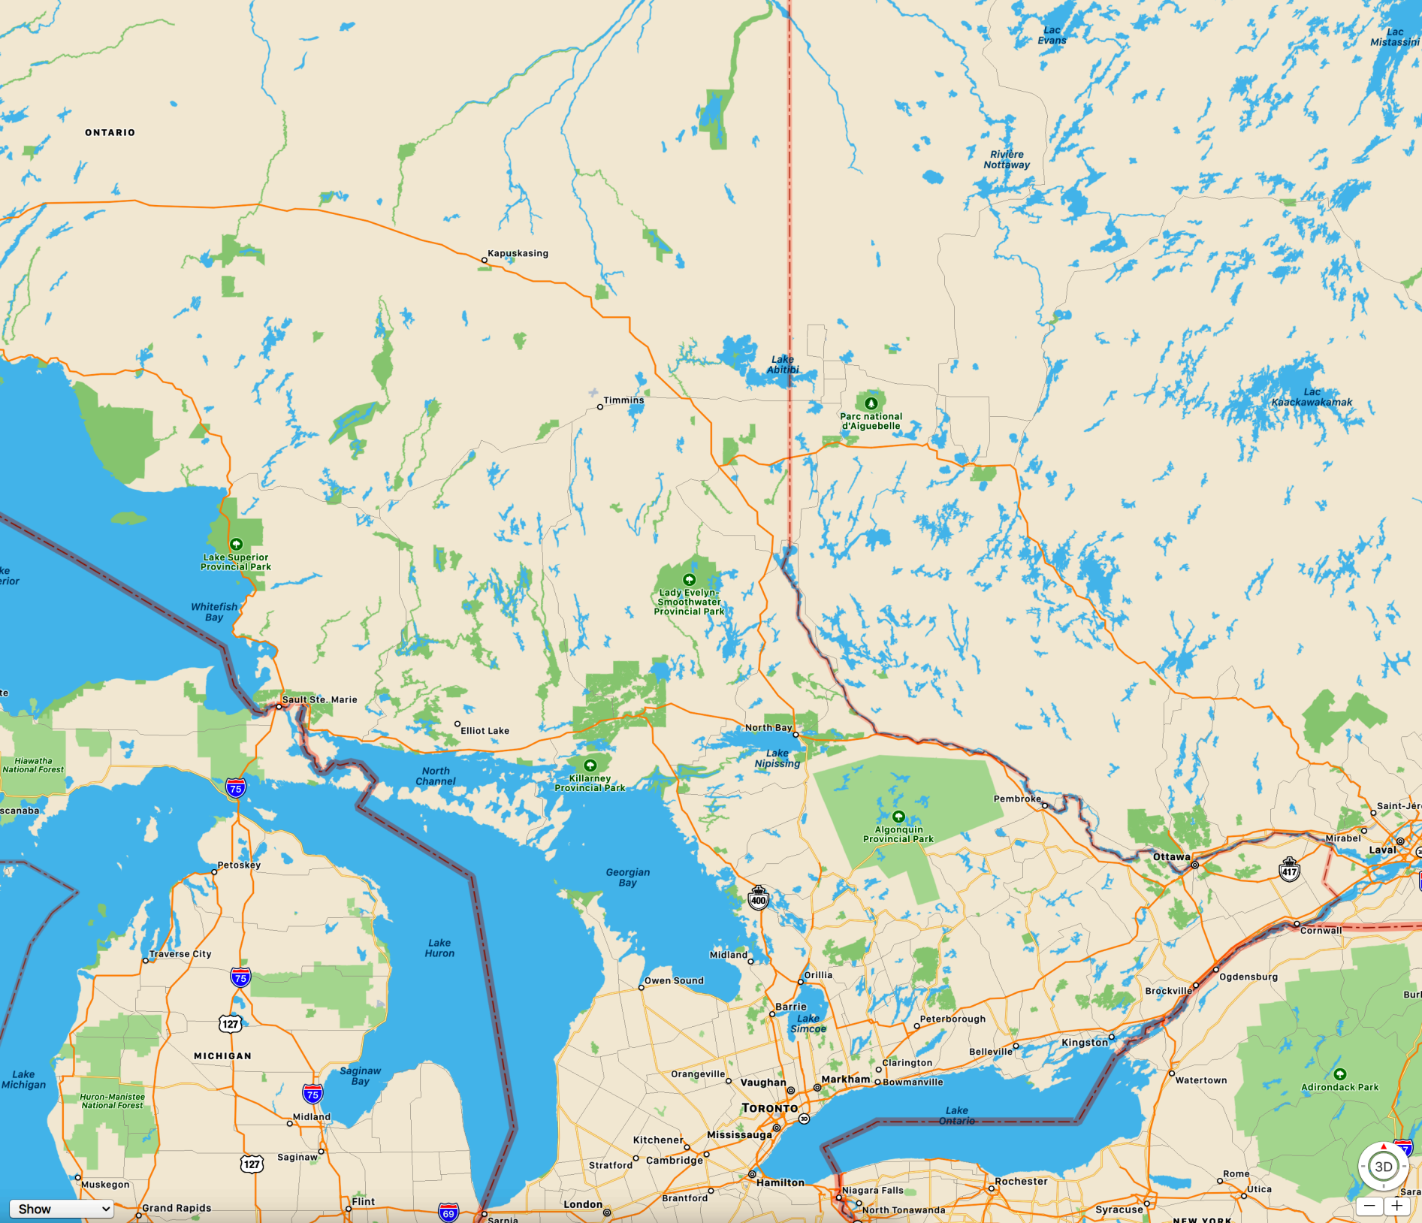
A Provincial Resource
ONTARIO
QUEBEC
*
*
*
*
*
*
Timmins
*
Faster
Better
Cheaper
The right pathologist for the right patient at the right time
*
*
~ 440 mile
Sault Ste Marie
~ 435 mile
*
*
*
Toronto
Oshawa

Slide 12
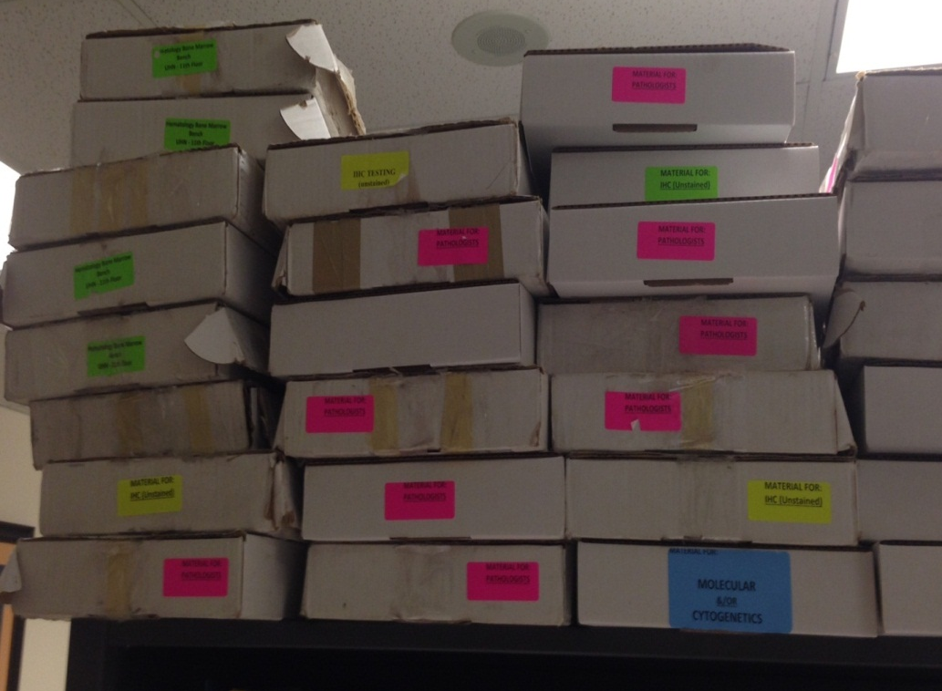
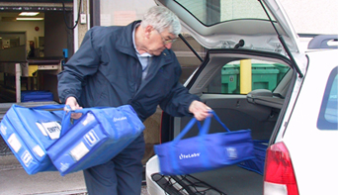
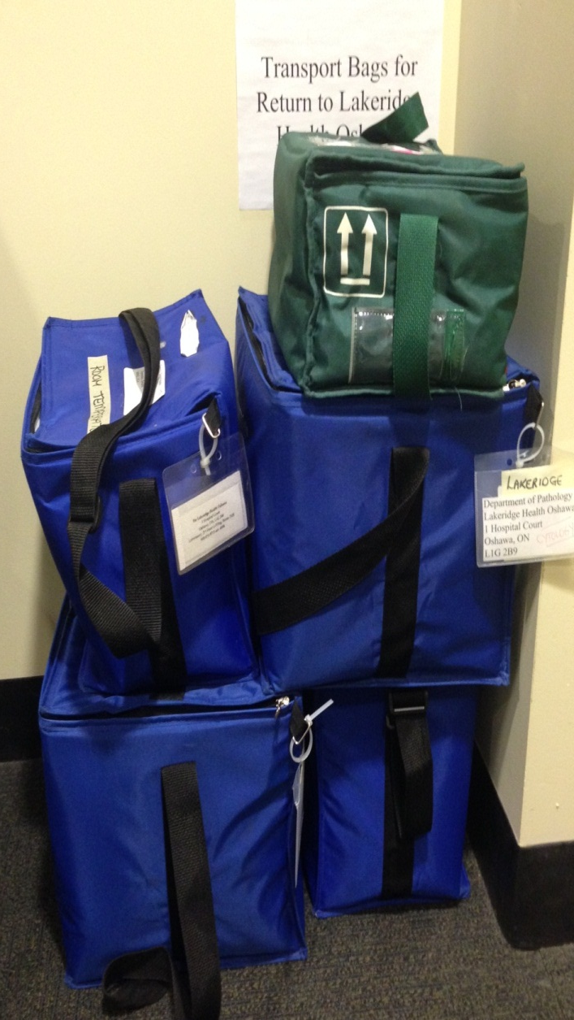
Do you move glass slides?
Do you move pathologists?
OR
Do you implement digital pathology?

Slide 13
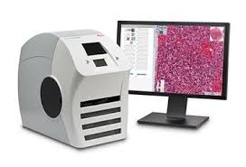
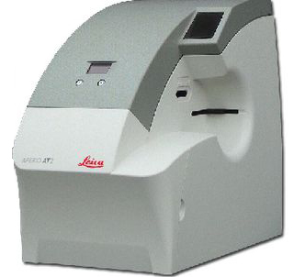
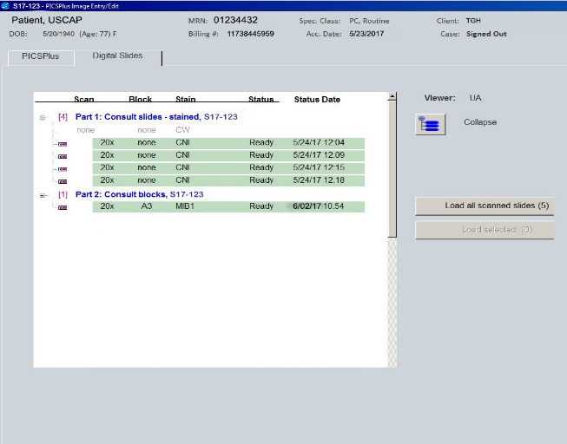
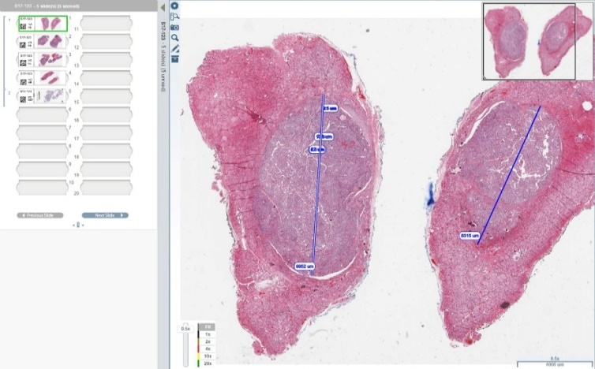
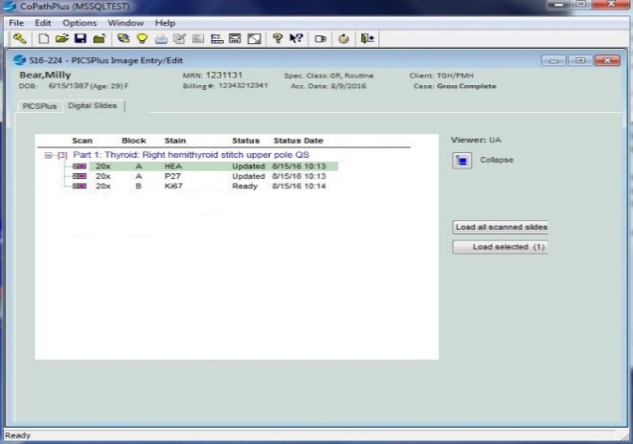
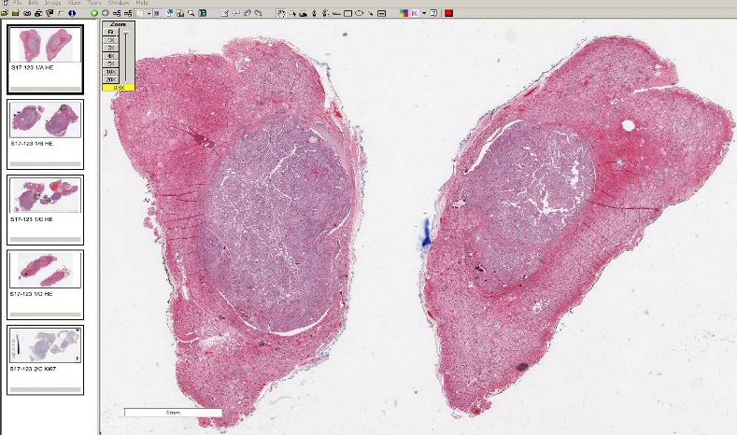
The Key to Success: LIS Integration
2010-11: Primary diagnosis for surgical pathology
LIS and Imagescope
PART 1: THYROID: RIGHT HEMITHYROID STITCH UPPER POLE QS
H&E
P27
MIB1
Volynskaya et al. Arch Pathol Lab Med 2018;142:369-382
Zoya Volynskaya

Slide 14
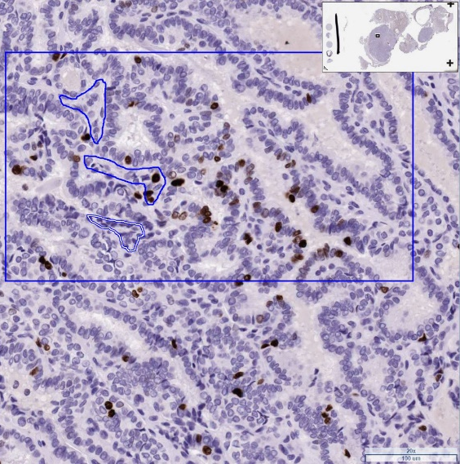
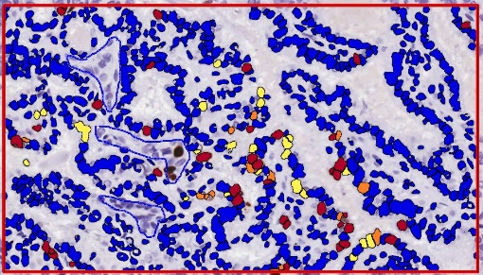
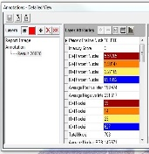
And the added bonus:
LIS & WebViewer --->
*Image Analysis done in ImageScope

Slide 15
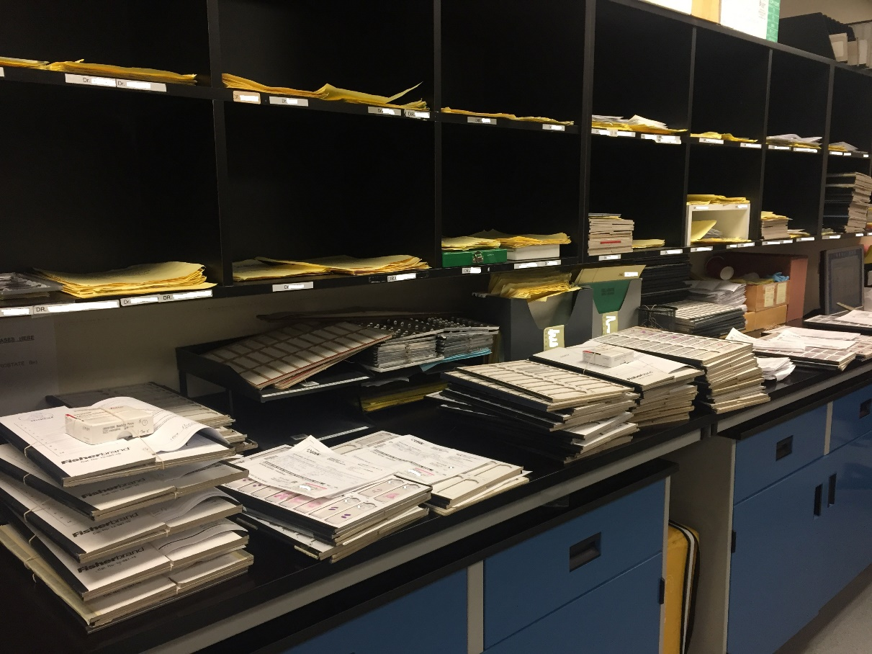
Digital Pathology Addresses Workflow Challenges
Integration of multiple slides into workflow for case signout
From the lab to the pathologist
IT integration is automated
LIS
Barcodes
Integration of new slides (recuts, deepers, IHC, etc) without need for slide reorganization
Volynskaya Z, Evans AJ, Asa SL: Adv Anat Pathol. 2017;24:215-221

Slide 16
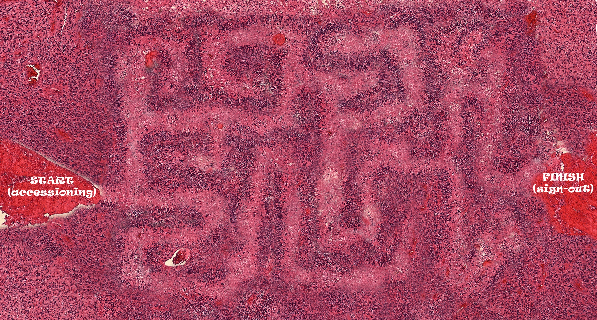
Pseudopalisading Maze. The Art Gallery of Pathology, By Rasmus Kiehl, Editor: Sylvia L. Asa, ARP Press 2020

Slide 17
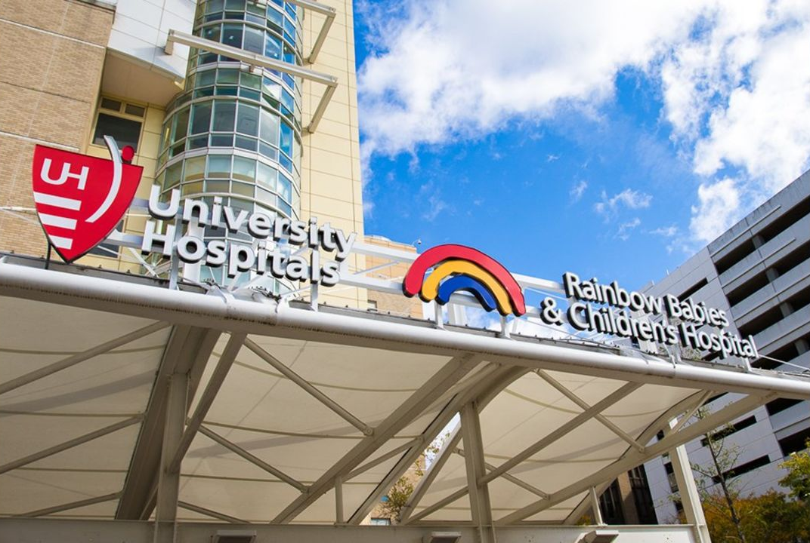
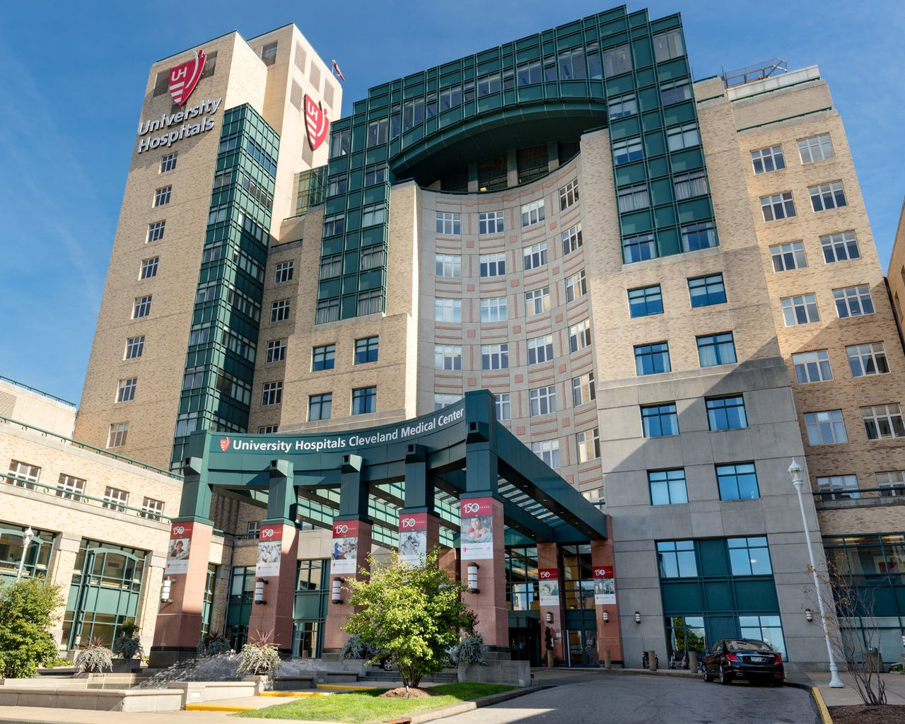
2019: Cleveland

Slide 18
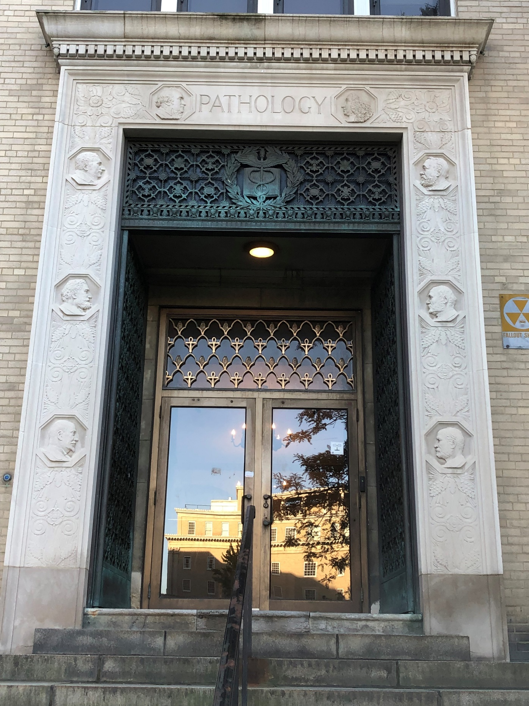
Institute of Pathology

Slide 19
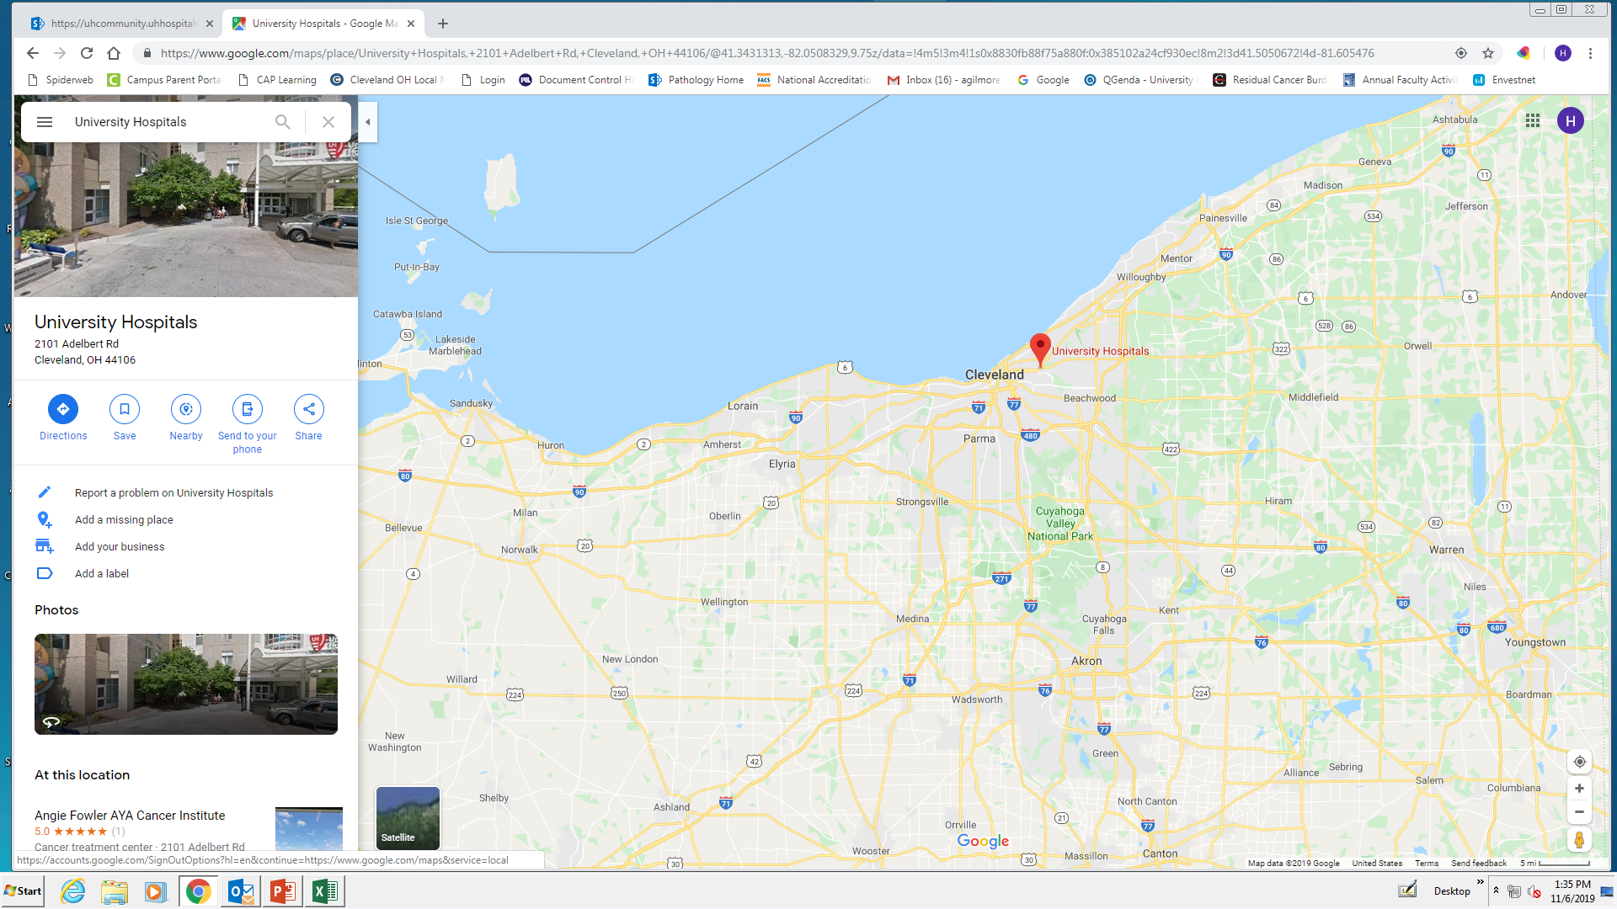
UH Pathology
Concord*
Willoughby*
Cleveland
Richmond
Geauga
St. John
Beachwood*
Ahuja
Bedford
Elyria
Parma
Portage
Western Reserve
Samaritan

Slide 20
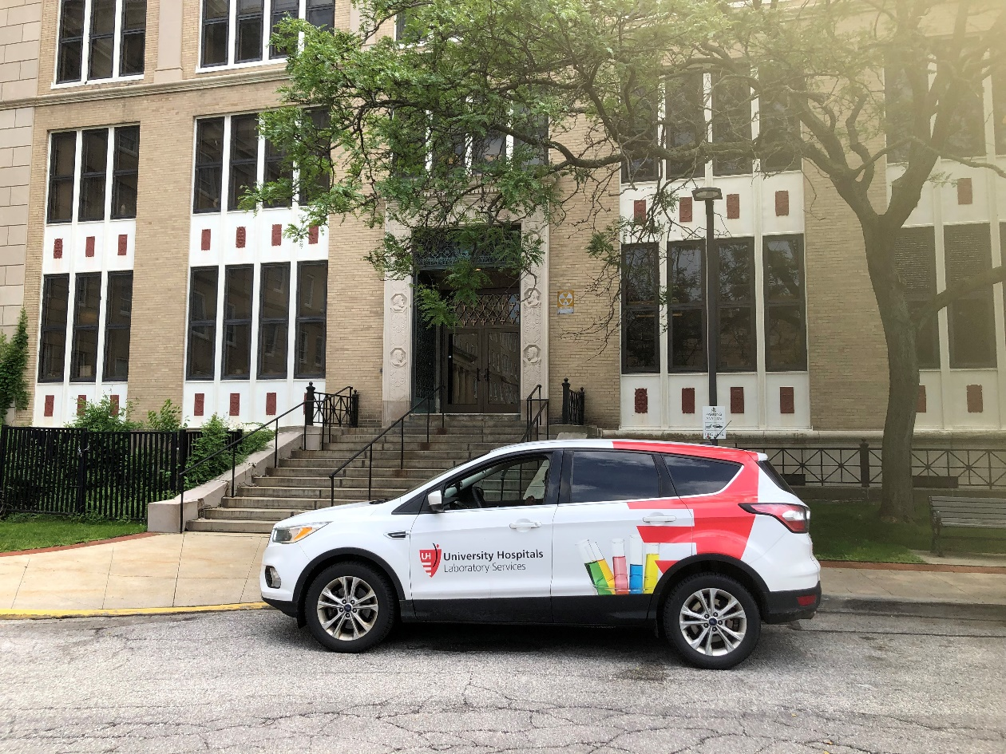
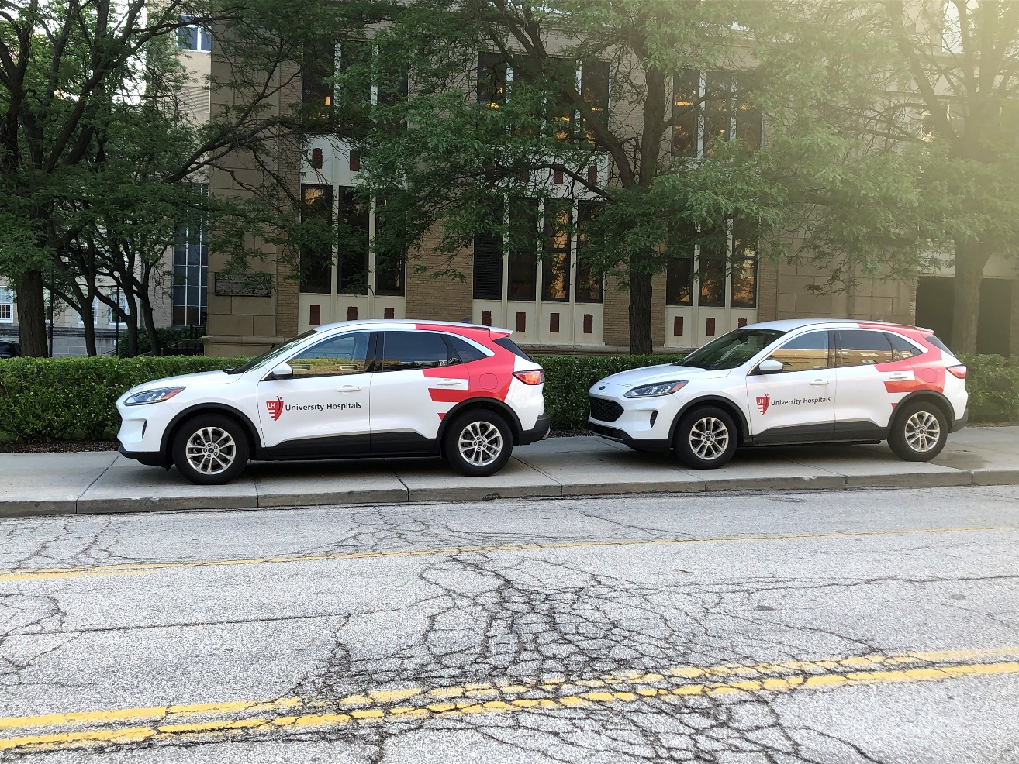
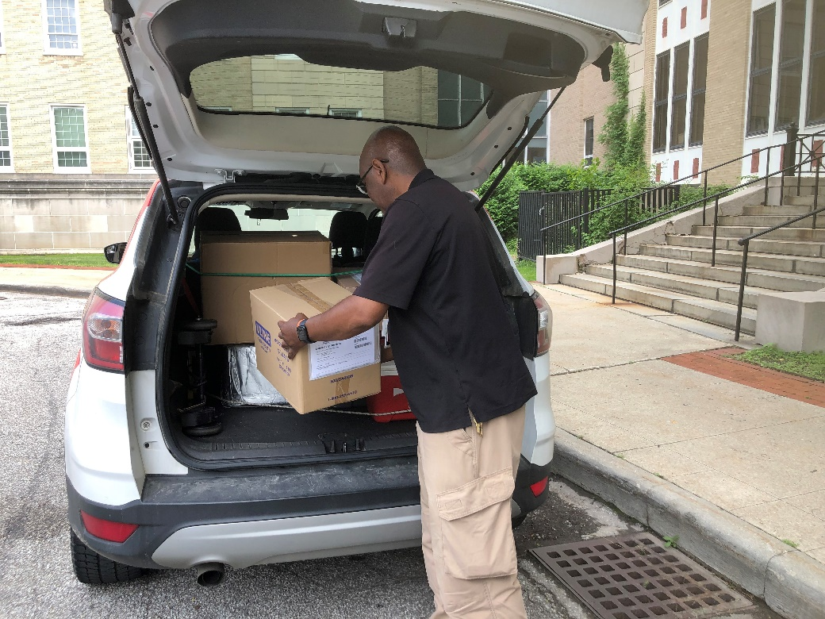
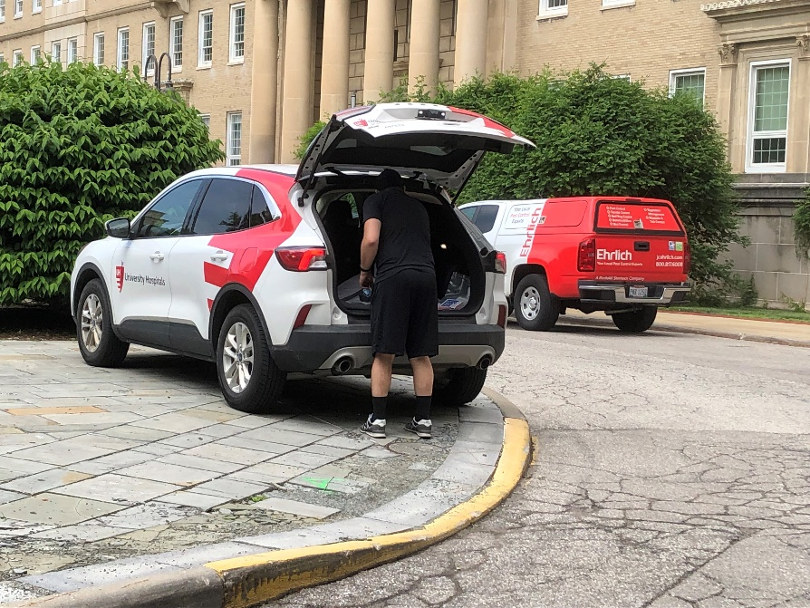
A Familiar Sight

Slide 21
Digital Pathology at UH
Phase 1 (2019)
Breast Radiology-Pathology Correlation conference
Scanning of slides for Tumor Boards
Scanning of all surgical cases sent to molecular lab for NGS
Scanning of all original cytology cases sent for molecular testing
Phase 2 (2020-2022)
Integration of Sectra with Cerner CoPath LIS
Provide IHC and special stain services to Community Hospitals to reduce TAT
Real-time consultation to Community Hospitals
Phase 3 (2023 and beyond)
Scanners at all UH Hospitals
Subspecialty frozen section interpretation in Community sites
Full digital work flow at all sites for primary diagnosis
Switch from Cerner CoPath to Epic

Slide 22
PACS – The Driver for this Project
PACS (picture archiving and communication system)
Imaging technology to securely store and digitally transmit electronic images and clinically-relevant reports
Radiologists were initially main users but also nuclear medicine, cardiology, gastroenterology and dermatology
This is a critical part of the digital pathology program
Sectra PACS at UH was supportive or/ a driver of DP

Slide 23
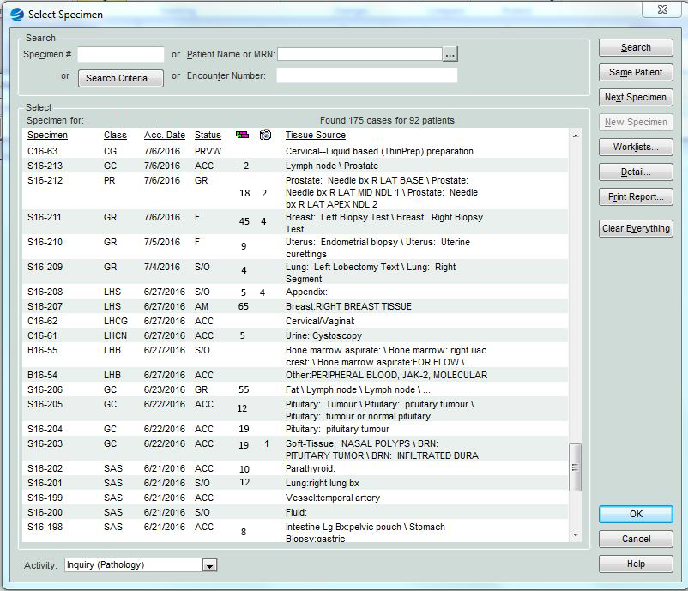
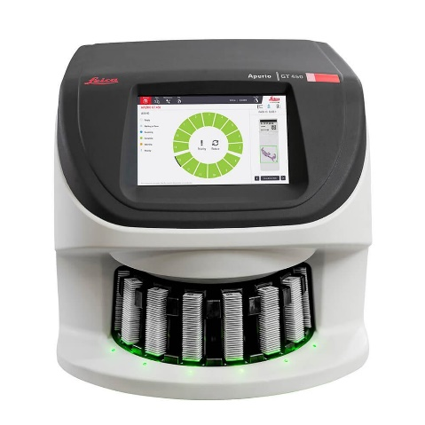
Cerner CoPath
Sectra Integration
Scanner agnostic
Roche* & Leica
* Z-stacking and 2x3” slides

Slide 24
Cerner CoPath
Sectra Integration
CoPath identifies scanned slides
Deficiency:
Number scanned
versus
Number to be scanned

Slide 25
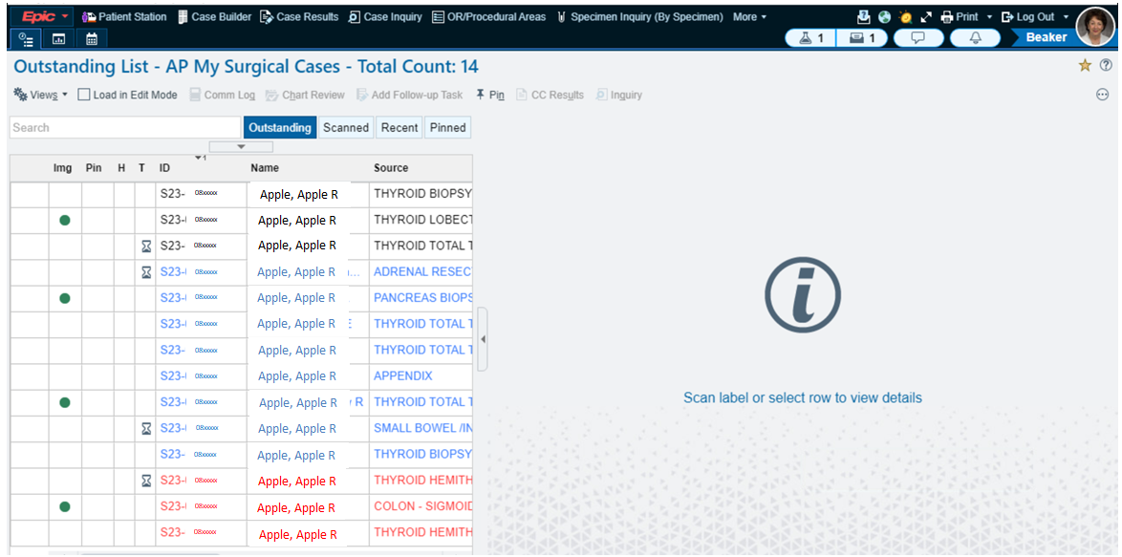
Epic-Sectra Integration

Slide 26
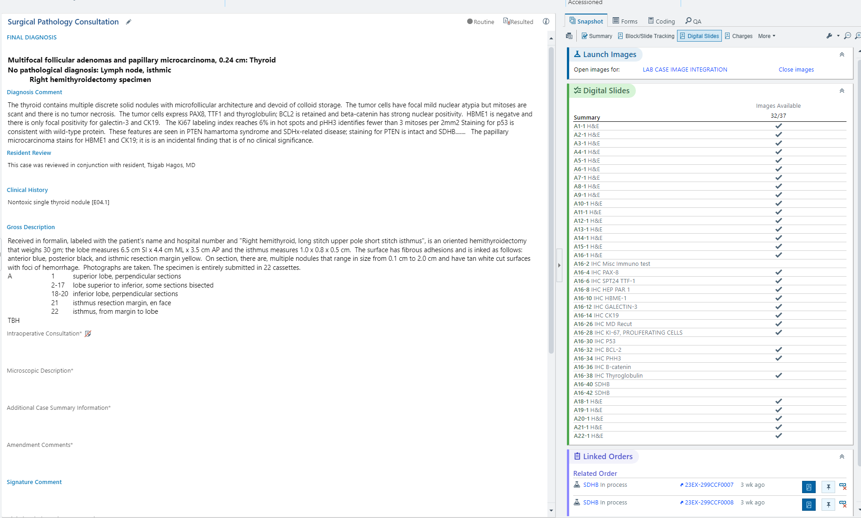
Epic-Sectra Integration

Slide 27
Sectra Integrates Pathology and Radiology
Can be accessed outside LIS;
Multiple viewers simultaneously

Slide 28
Auto-Synchronized Multi-slide Views
What you cannot do with

Slide 29
Image Analysis – Ki67

Slide 30
How do I Know What to Buy?

Slide 31
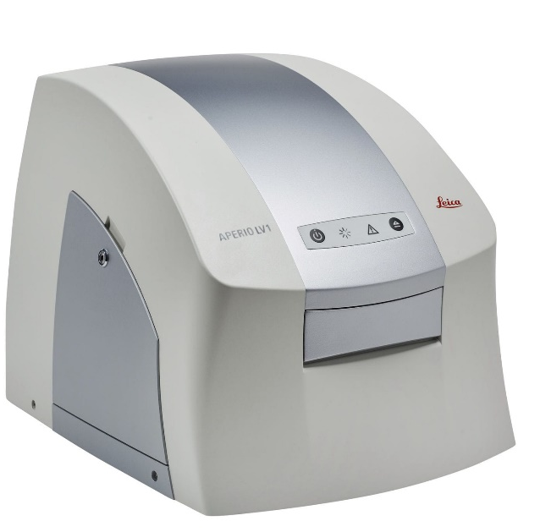
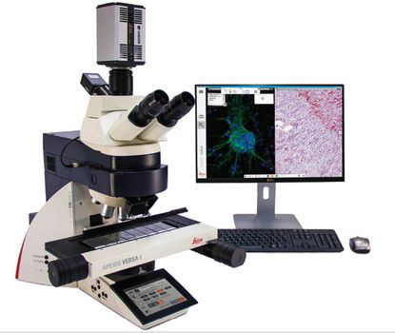
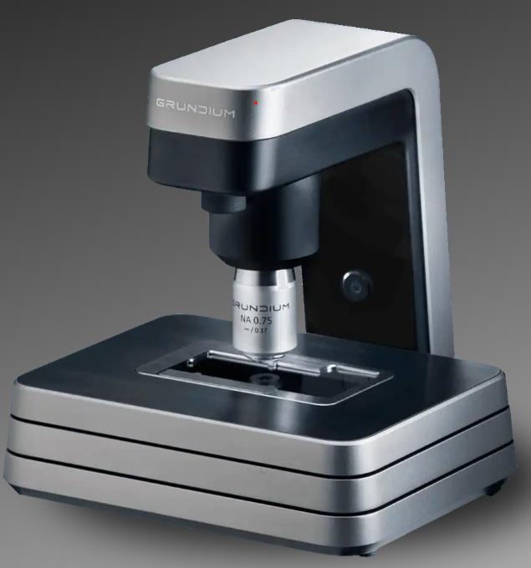
WSI for Intraoperative Consultations and ROSE
Minimal requirements
Single slide scanner, mobile capacity
Live view
No need for LIS integration (but better if you can!)

Slide 32
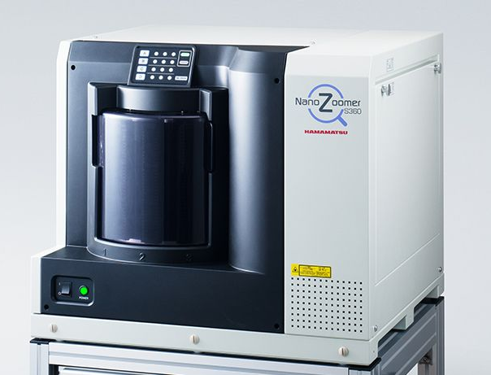
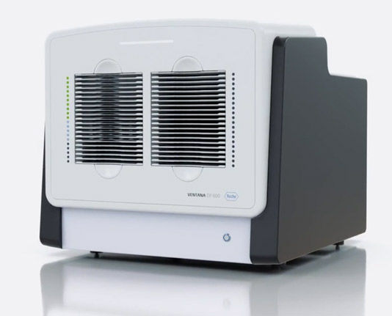
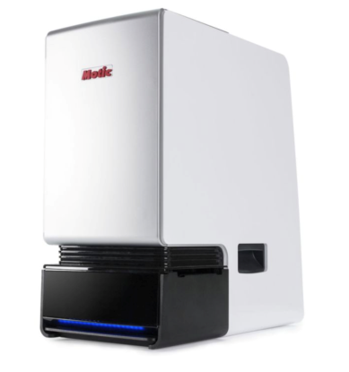
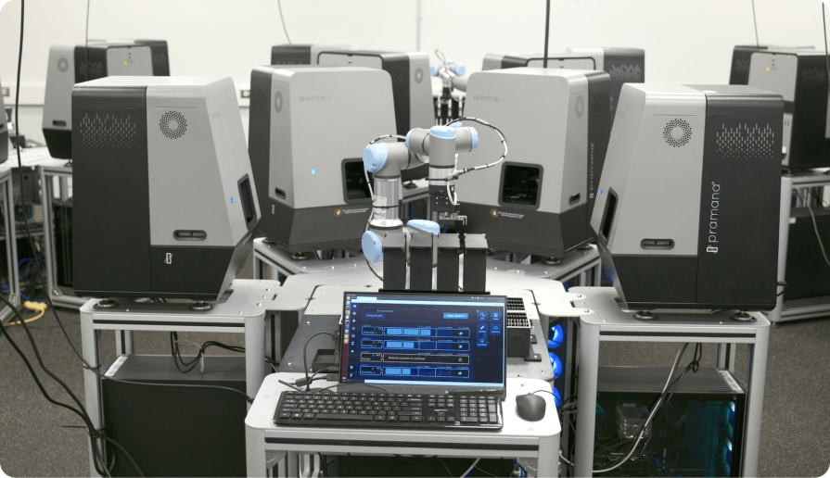
Technologic Advances In Scanners
More choices, increasing slide capacity (and smaller footprint)
Faster: 20x scans to now 40x routine

Slide 33
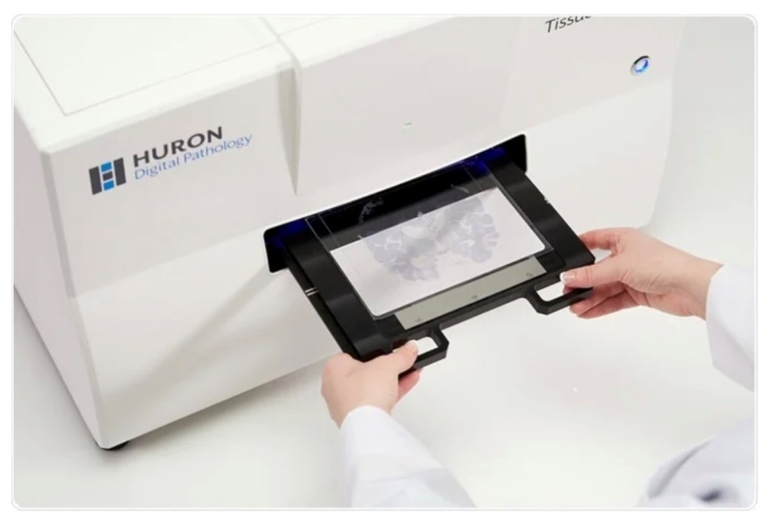
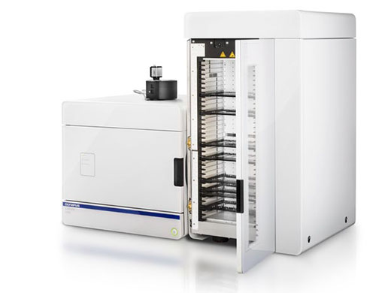
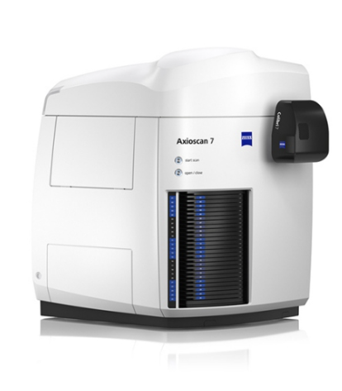
More Technologic Advances
Z-stacking
Darkfield
2” x 3“ slides

Slide 34
Viewers and PACS for Digital Pathology: Scanner Based or Scanner Agnostic?
Toronto
Leica scanners only
Leica image management system (IMS)
No clear PACS solution
Cleveland
Sectra is scanner agnostic
Many choices available today!

Slide 35
PACS Issues to Consider
Storage capacity
Cloud
Tiered
Access
Pathologists, trainees, other physicians and trainees, others
Patients
Ownership
Radiology/Pathology/Nuclear Medicine/Endoscopy
Institutional policies re: setup and changes

Slide 36
What About AI?

Slide 37
The Benefits of AI
AI integrated into workflow
Saves time
Enhances accuracy and quality
Removes boring jobs
Searching
Counting
Measuring

Slide 38
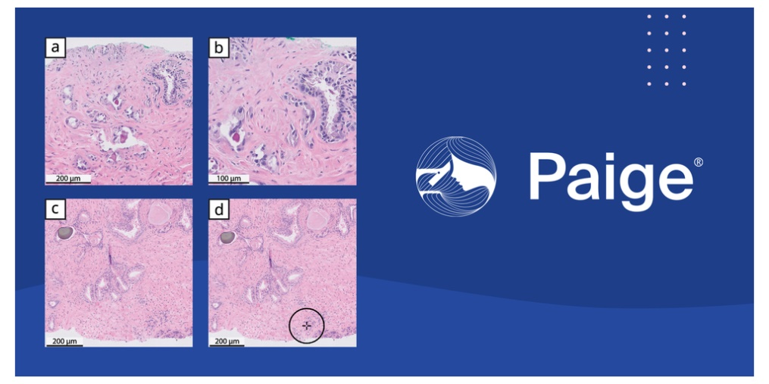

Slide 40
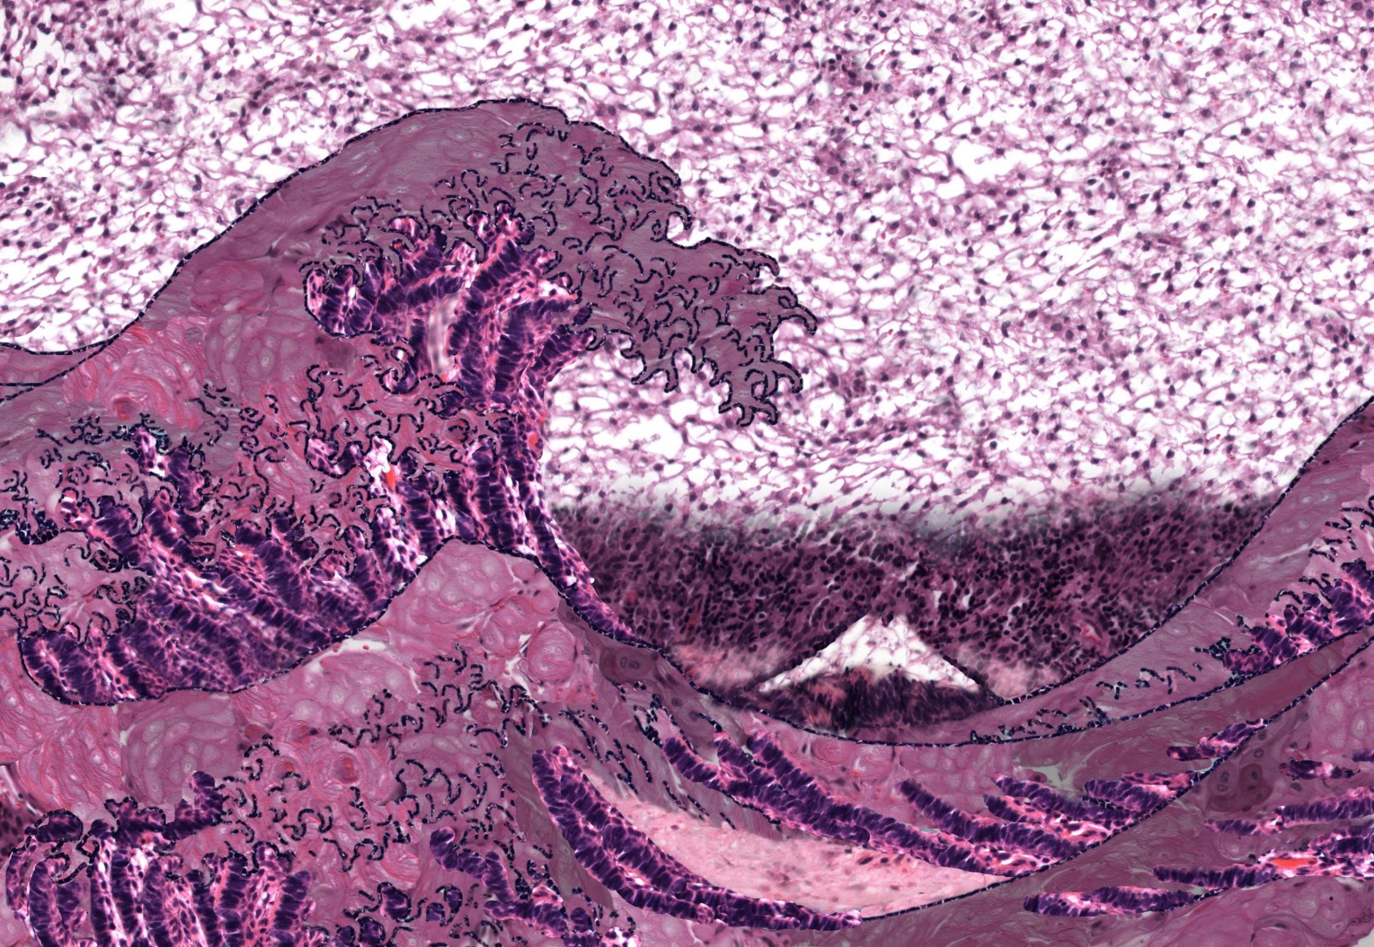
The Great Wave of Wet Keratin. The Art Gallery of Pathology, By Rasmus Kiehl, Editor: Sylvia L. Asa, ARP Press 2020

Slide 41
Computer-Assisted Diagnostics
QA of technical quality
Section thickness
Stain quality
? Need for Westgard rules in AP?

Slide 42
We Need Real “Smart” Scanners
Garbage In - Garbage Out. The Art Gallery of Pathology, By Rasmus Kiehl, Editor: Sylvia L. Asa, ARP Press 2020

Slide 43
Be Sure to Include Everyone
Pathologists
Histologists
IT engineers
Management
Finance
The Naysayers

Slide 44
Pathologists: Build it and they will come
Find the carrots
Peer Pressure
*Image Analysis done in ImageScope
Yes, you can work from home…………
…. sometimes!

Slide 45
Dancing with the Star Cells. The Art Gallery of Pathology, By Rasmus Kiehl, Editor: Sylvia L. Asa, ARP Press 2020

Slide 46
In a time of drastic change it is the learners who inherit the future. The learned usually find themselves equipped to live in a world that no longer exists.
Eric Hoffer

Slide 47
How Do I Find the $$
Grant
Philanthropy
Sell it to the C-suite
? Reimbursement
But don’t let that stop you!

Slide 48
Find the ROI

Slide 49
WSI Fixes………
Volynskaya et al, Adv Anat Pathol. 2017 Jul;24(4):215-221.

Slide 50
ROI Even for A Single Site Institution
Rapid retrieval of patient’s previous pathology
No more recuts when slides go missing
Faster TAT on IHC and special stains
No more “educational recuts” for residents and fellows

Slide 51
Consults and Patient Requests for Second Opinion
DVD or USB with
pdf of the report
gross photos
all slides digitized
viewer provided
My pathology report

Slide 52
The Value of a Good Biobank
Research Fame
Money
TCGA Contractor Evaluation
Quality: Exceptional
This group was highly dedicated to the project….. they had a good pass rate at the level of pathology review and an exceptional pass rate at molecular. This later aspect is unique ..… Their samples passed at rates significantly higher than other samples of similar tumor types over a comparable period.
We would definitely work with this group again. Not only did this group provide timely and accurate estimations of their sample numbers, but the group was able to provide them rapidly. …. The group had incredibly high quality samples.

Slide 53
Be sure you understand the goal
My vision is a fully digital department
Knowing what you want is the first and most important step in creating a better future.

Slide 54
We Can
Diagnose It!
The Art Gallery
of Pathology
By Rasmus Kiehl
Editor: Sylvia L. Asa
ARP Press 2020

Slide 55
Multisite Primary Diagnosis by Subspecialty
Quality improvement with subspecialization validated in other fields
not only for complex, difficult and unusual cases
more efficient for routine cases; unusual features detected earlier
Subspecialization reduces error, increases quality and decreases cost
avoids need for referral to a subspecialist academic in a tertiary care center
Reduces delays in clinical care, errors in treatment …….. $$$$
Clinical integration → impact of diagnosis on the patient
need to deal with demands of interacting with multiple care teams
Requires volumes to ensure sustainability, cost effectiveness & redundancy

Slide 56
Subspecialty Pathology Before DP ………..
Volynskaya et al. Arch Pathol Lab Med 2018;142:369-382

Slide 57
…… and After
Volynskaya et al. Arch Pathol Lab Med 2018;142:369-382

Slide 58
Quality Measures in Pathology
Within the subspecialist groups, review of cases before signout prevents potential serious errors without delaying reporting time
WSI facilitates immediate intradepartmental (even remote) consultation
Outcome measures require validation outside the laboratories
Indirect measures of pathology quality:
academic productivity, national and international education, research and development
The main ROI from DP is not in lab savings but rather in the savings that will accrue outside the lab, in the clinics and on the wards of the Hospitals
Outcome measures require validation outside the laboratories

Slide 59
Digital Pathology Supports Subspecialization of Pathologists
Get the right slides to the right pathologist(s) at the right time

Slide 60
Information
Knowledge
The Mighty Scream
The Art Gallery of Pathology
By Rasmus Kiehl
Editor: Sylvia L. Asa
ARP Press 2020
Wisdom

Slide 61
The Best Way to Predict the Future is to Invent it
Alan Kay
It would be hard to imagine a situation where a patient does not know their oncologist or surgeon. However, despite the fact that pathologists play a critical role in the diagnosis, prognosis and prediction of every patient’s disease, few patients know their pathologist.

Slide 62
When Digital Pathology IS Pathology
WSI is implemented to replace all light microscopy
AI algorithms are presented alongside biomarkers and NGS at pathology meetings
Like all other technologies, AI algorithms will have limitations
Pathology will continue to search for and implement new and better ways to make the right diagnosis, reach the correct prognosis, and predict the right therapeutic approaches
The Immuna Lisa
The Art Gallery of Pathology
By Rasmus Kiehl
Editor: Sylvia L. Asa
ARP Press 2020
………………………………………………..………..Because…………………………………………..………………

Slide 63
Sir William Osler
As is our pathology,
so is our practice;
what the pathologist thinks today,
the physician does tomorrow
Osler W. An Address on the Treatment of Disease, June 3, 1909.
British Medical Journal July 24, 1909, pp 185-9.

Slide 64
The Art Gallery of Pathology
By Rasmus Kiehl
Editor: Sylvia L. Asa
ARP Press 2020

